Slide 1
Lecture 1
Computer Simulation
Prof. Dr.Abbas H. Hassin Alasadi
Computer Information System
Computer Science and Information Technology
Basrah University
Email: abbashh2002@gmail.com

Slide 2
Systems and System Environment
A system is defined as a groups of objects that are joined together in some regular interaction toward the accomplishment of some purpose.
An automobile factory: Machines, components parts and workers operate jointly along assembly line
A system is often affected by changes occurring outside the system: system environment.
Factory : Arrival orders
Effect of supply on demand : relationship between factory
output and arrival (activity of system)
Banks : arrival of customers

Slide 3
Systems Components
Entity :An object of interest in the system : Machines in factory
Attribute : The property of an entity : speed, capacity
Activity :A time period of specified length :welding, stamping
State :A collection of variables that describe the system in any time : status of machine (busy, idle, down,…)
Event : A instantaneous occurrence that might change the state of the system: breakdown
Endogenous (ذاتي النمو): Activities and events occurring with the system
Exogenous (خارجي): Activities and events occurring with the environment.

Slide 4
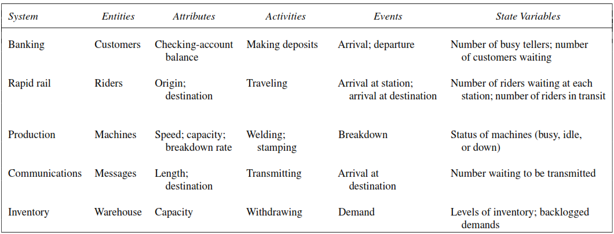
Examples of Systems and their Components

Slide 5
Model of a System
To study the system
it is sometimes possible to experiments with system
This is not always possible (bank, factory,…)
A new system may not yet exist
Model: construct a conceptual framework that describes a system
It is necessary to consider those accepts of systems that affect the problem under investigation (unnecessary details must remove)

Slide 6
Types of Models
Models can be classiﬁed as being mathematical or physical.
A mathematical model uses symbolic notation and mathematical equations to represent a system.
A simulation model is a particular type of mathematical model of a system.
A physical model is a larger or smaller version of an object such as the enlargement of an atom or a scaled-down version of the solar system.

Slide 7
The End of Lecture 1

